Slide 1
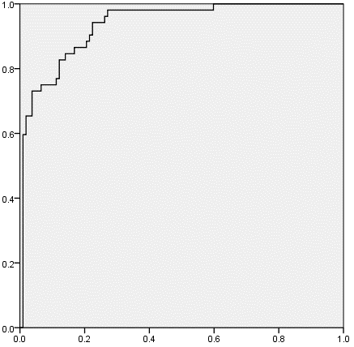
3 Hz
AUC = 0.94

Slide 2
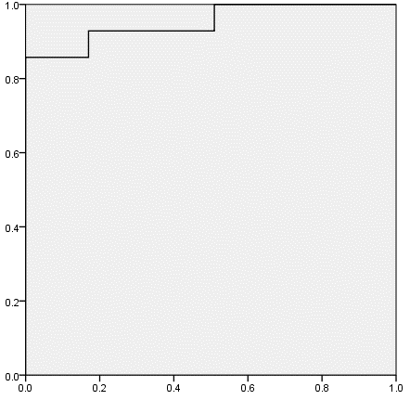
3 Hz
Myopia
AUC = 0.95

Slide 3



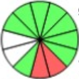
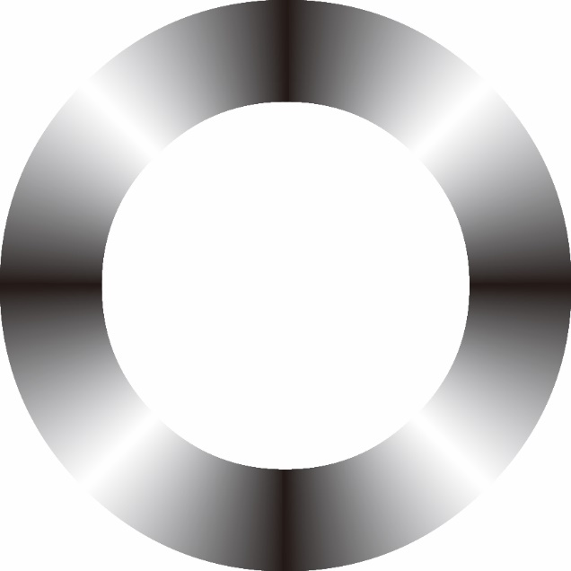

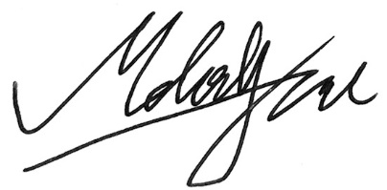
1 Hz
2 Hz
3 Hz
4 Hz
5 Hz
Notes:
Figure 1. Sketch of discrete fourier transform demonstrates that 12 equidistant data of thickness of circumpapillary retina nerve fiber layer could be represented as the combination of consecutive different frequency of the thickness. In 1 Hz, for example, the circle symbol indicates the peak, and the triangle symbol indicates the trough, so there is one cycle in a round (1 Hz).

Slide 4
All subjects
High myopia group
3 Hz
3 Hz
True positive rate
True positive rate
AUC = 0.94
AUC = 0.95
False positive rate
False positive rate
Notes:
Figure 2. The receiver operating characteristic curve analysis of 3 Hz showed that area under curve was 0.94 and 0.95 for diagnosing glaucoma in all subjects and myopia group (axial length ≥ 26mm) respectively. In all subjects, 3 Hz showed a 84.6% and 86.0% sensitivity and specificity, respectively, on cutoff value as 78 amplitude units. In myopia group, 3 Hz showed a 85.7% and 90.6% sensitivity and specificity, respectively, on cutoff value as 78 amplitude units.

